Slide 1
SMART CONTRACT/TENDER MANAGEMENT SYSTEM USING BLOCKCHAIN Victor_Aliche_Review_12-12-2022

Slide 2

Hello!
I am Victor Aliche, the pleasure is mine as I present my personal project on SMART CONTRACT/TENDER MANAGEMENT SYSTEM USING BLOCKCHAIN.
As it may interest you, find me at https://github.com/Alichevictor
Victor Aliche SOFTWARE ENGINEER

Slide 3
TIMELINE TO DELIVERY
2022
2023
Building the front end, backend, and integrating the smart contract, bids and procurement
GitHub, and Local Repository Setup
Building the smart contract
OCT
NOV
DEC
JAN
MVP
Continuous Developments and advancement
Research/Finding Stage

Slide 4
Problems with Existing System
1. Provenance Tracking (Hard to track down)
2. Corruption by middle men
3. Lack of trust
4. Excessive cost due volatility and discrepancies
5. Lack of improvisation ability
6. The Governmental agency executives awarding the tenders can indulge in corruption by accepting bribes from a particular organisation and awarding them the tender in spite of poor proposals and high costs.
7. Taxpayers of the country have very little knowledge of how and where our tax money is used.

Slide 5
AIMS/ PURPOSES FOR THE PROJECT
Basically, the aims of this project epicenters its strength on solving the aforementioned problems with existing system.
How this could be achieved through this project are given as thus:
1: Addressing the problem of lack of provenance tracking and lack of improvisation ability—This would be achieved by building a strong authentication endpoint where anyone can track with contract or item id, can get present status as well as complete record of history.
2: Addressing the corruption by middle men---This would be achieved through Decentralization, Immutability due to blockchain secured system
3: Solving the problem of lack of trust through the transparency that characterize blockchain.
4: Cutting excessive cost due to transparency that characterize blockchain
5: Addressing the problem of corruption among Government agencies and Executives in awarding contracts and tenders due to transparency that characterize the blockchain secured system.

Slide 6
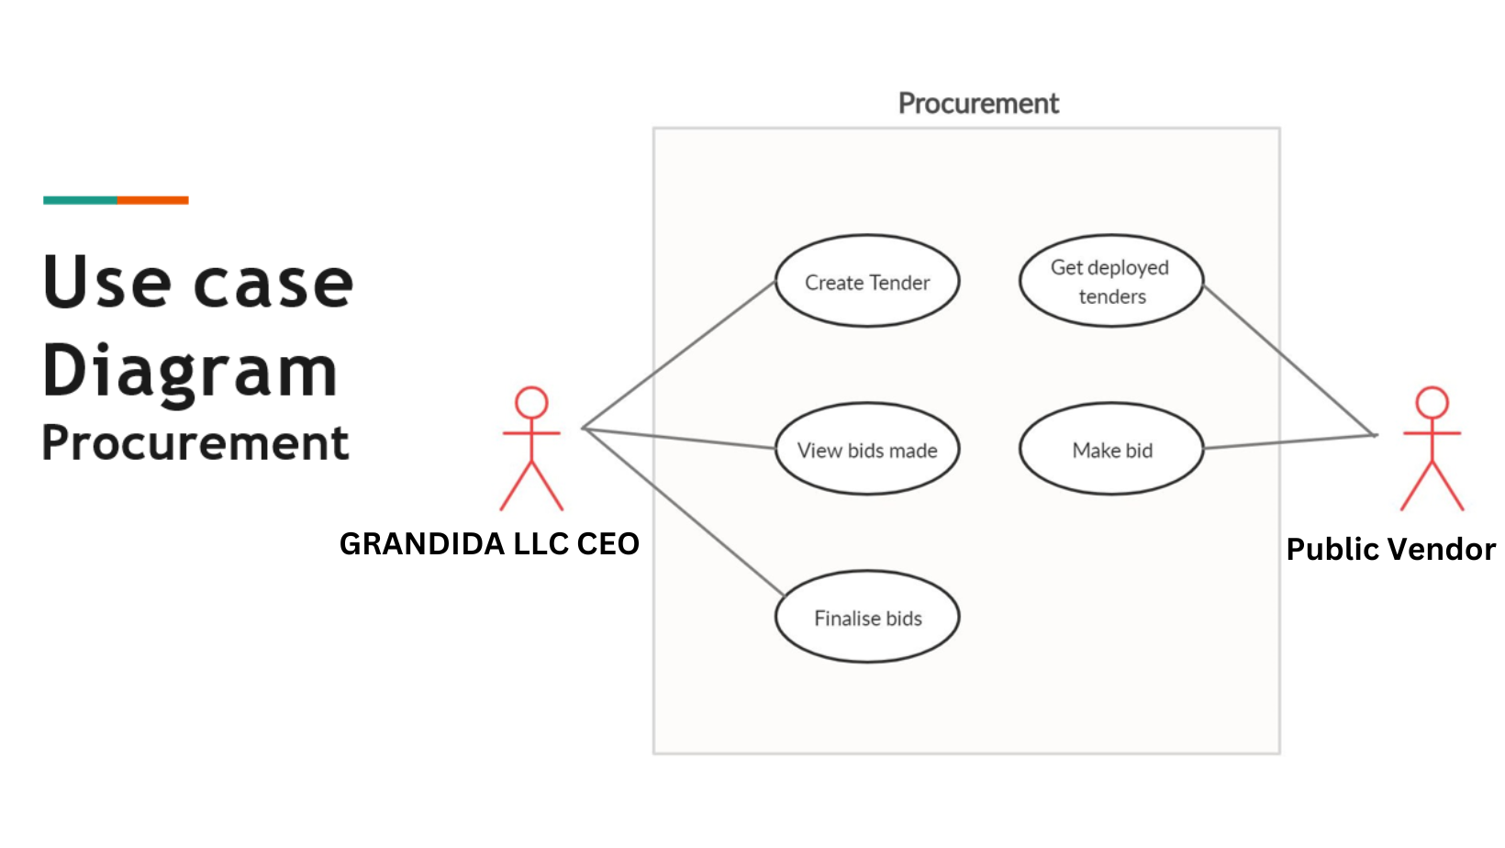

Slide 7
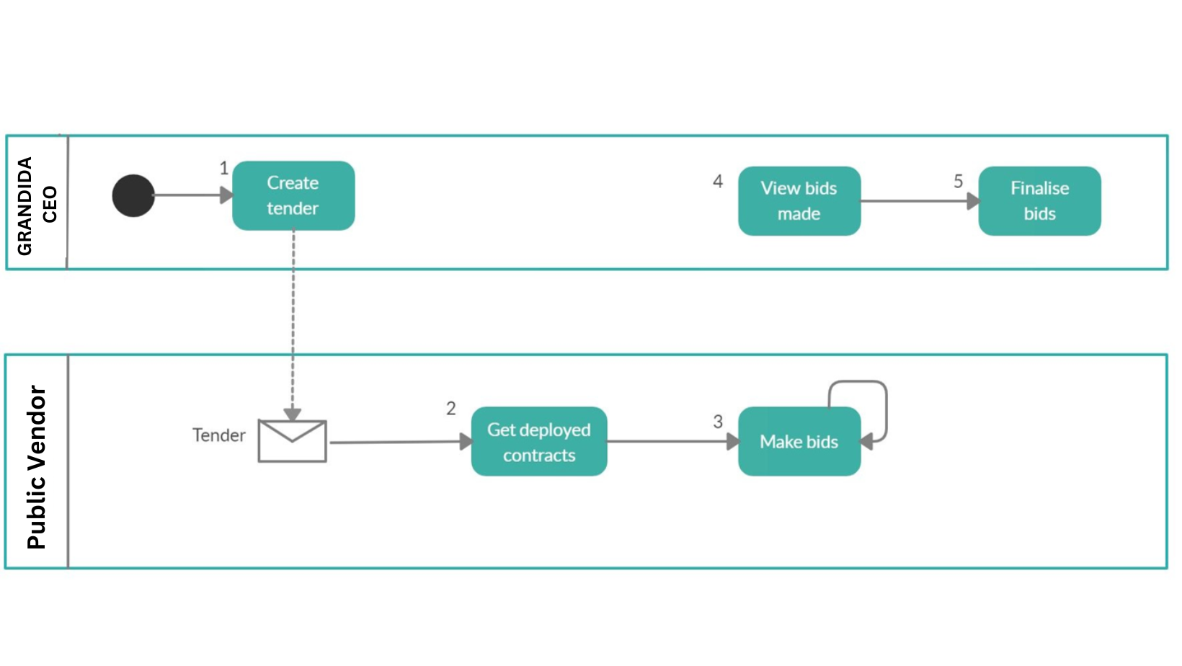

Slide 8
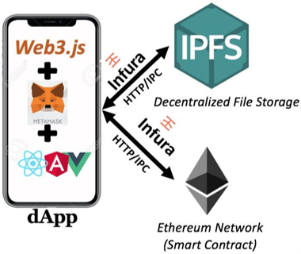
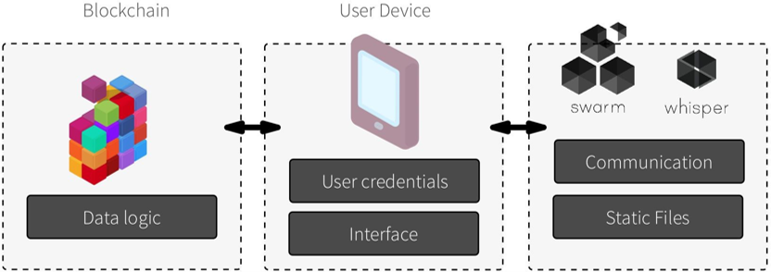
Technology Stack (Basic)

Slide 9
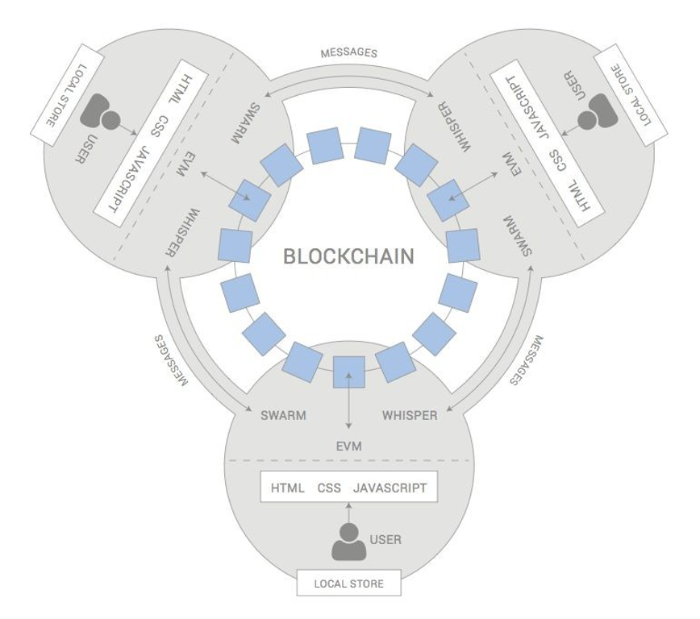
Technology Stack (Elaborated)

Slide 10
Beneﬁts of my project
Problem with Existing Solution
Lack of Provenance Tracking Lack of Improvisation ability | Anyone can track with item id, can get present status as well as complete record of history
Corruption by middle men | Decentralization, Immutability due to blockchain
Lack of trust | Transparency due to blockchain
Excessive cost | Transparency due to blockchain

Slide 11
CuRRENT STAge of my project
Front end and smart contract integrations

Slide 12
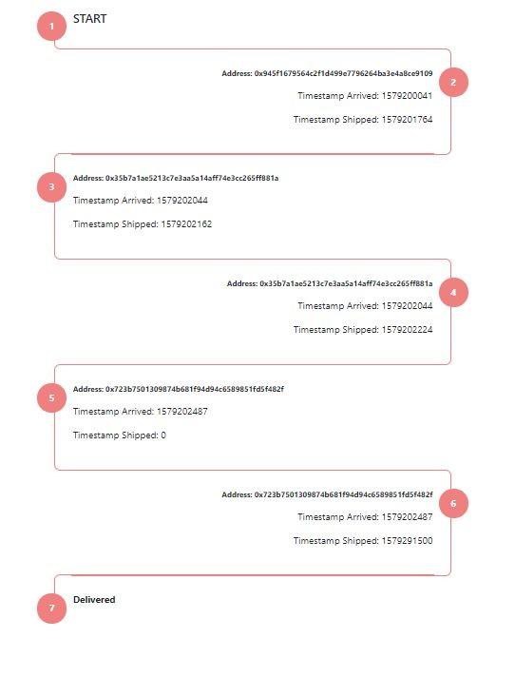
Thank you
Questions?

